Slide 1

Measuring biodiversity its change
Modelling species distribution and biodiversity patterns
MLU 2021
shane.blowes@idiv.de

Slide 2
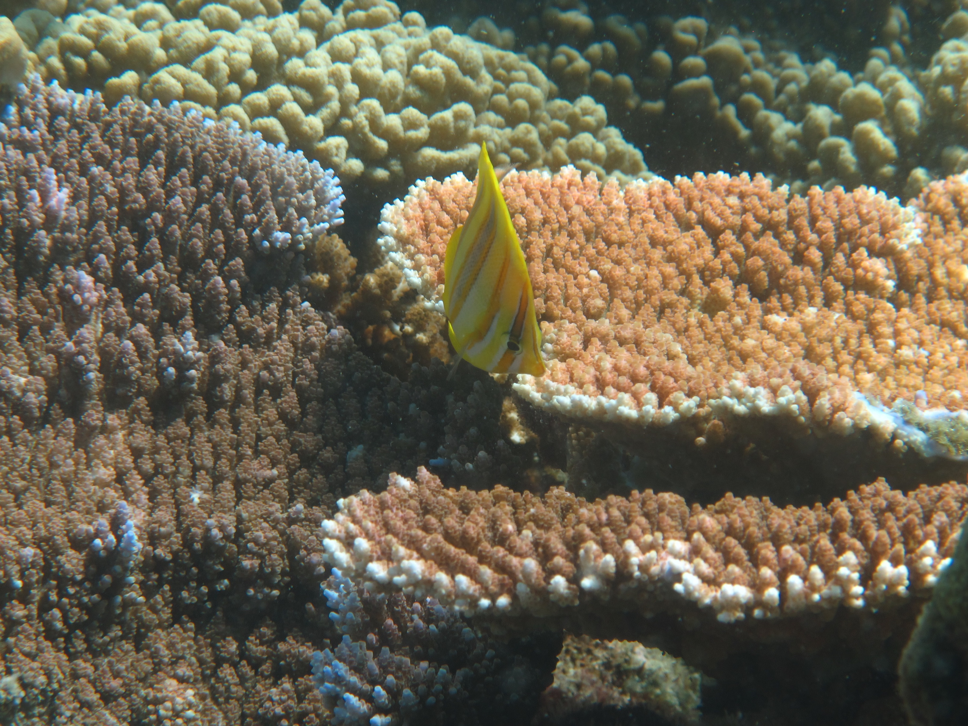
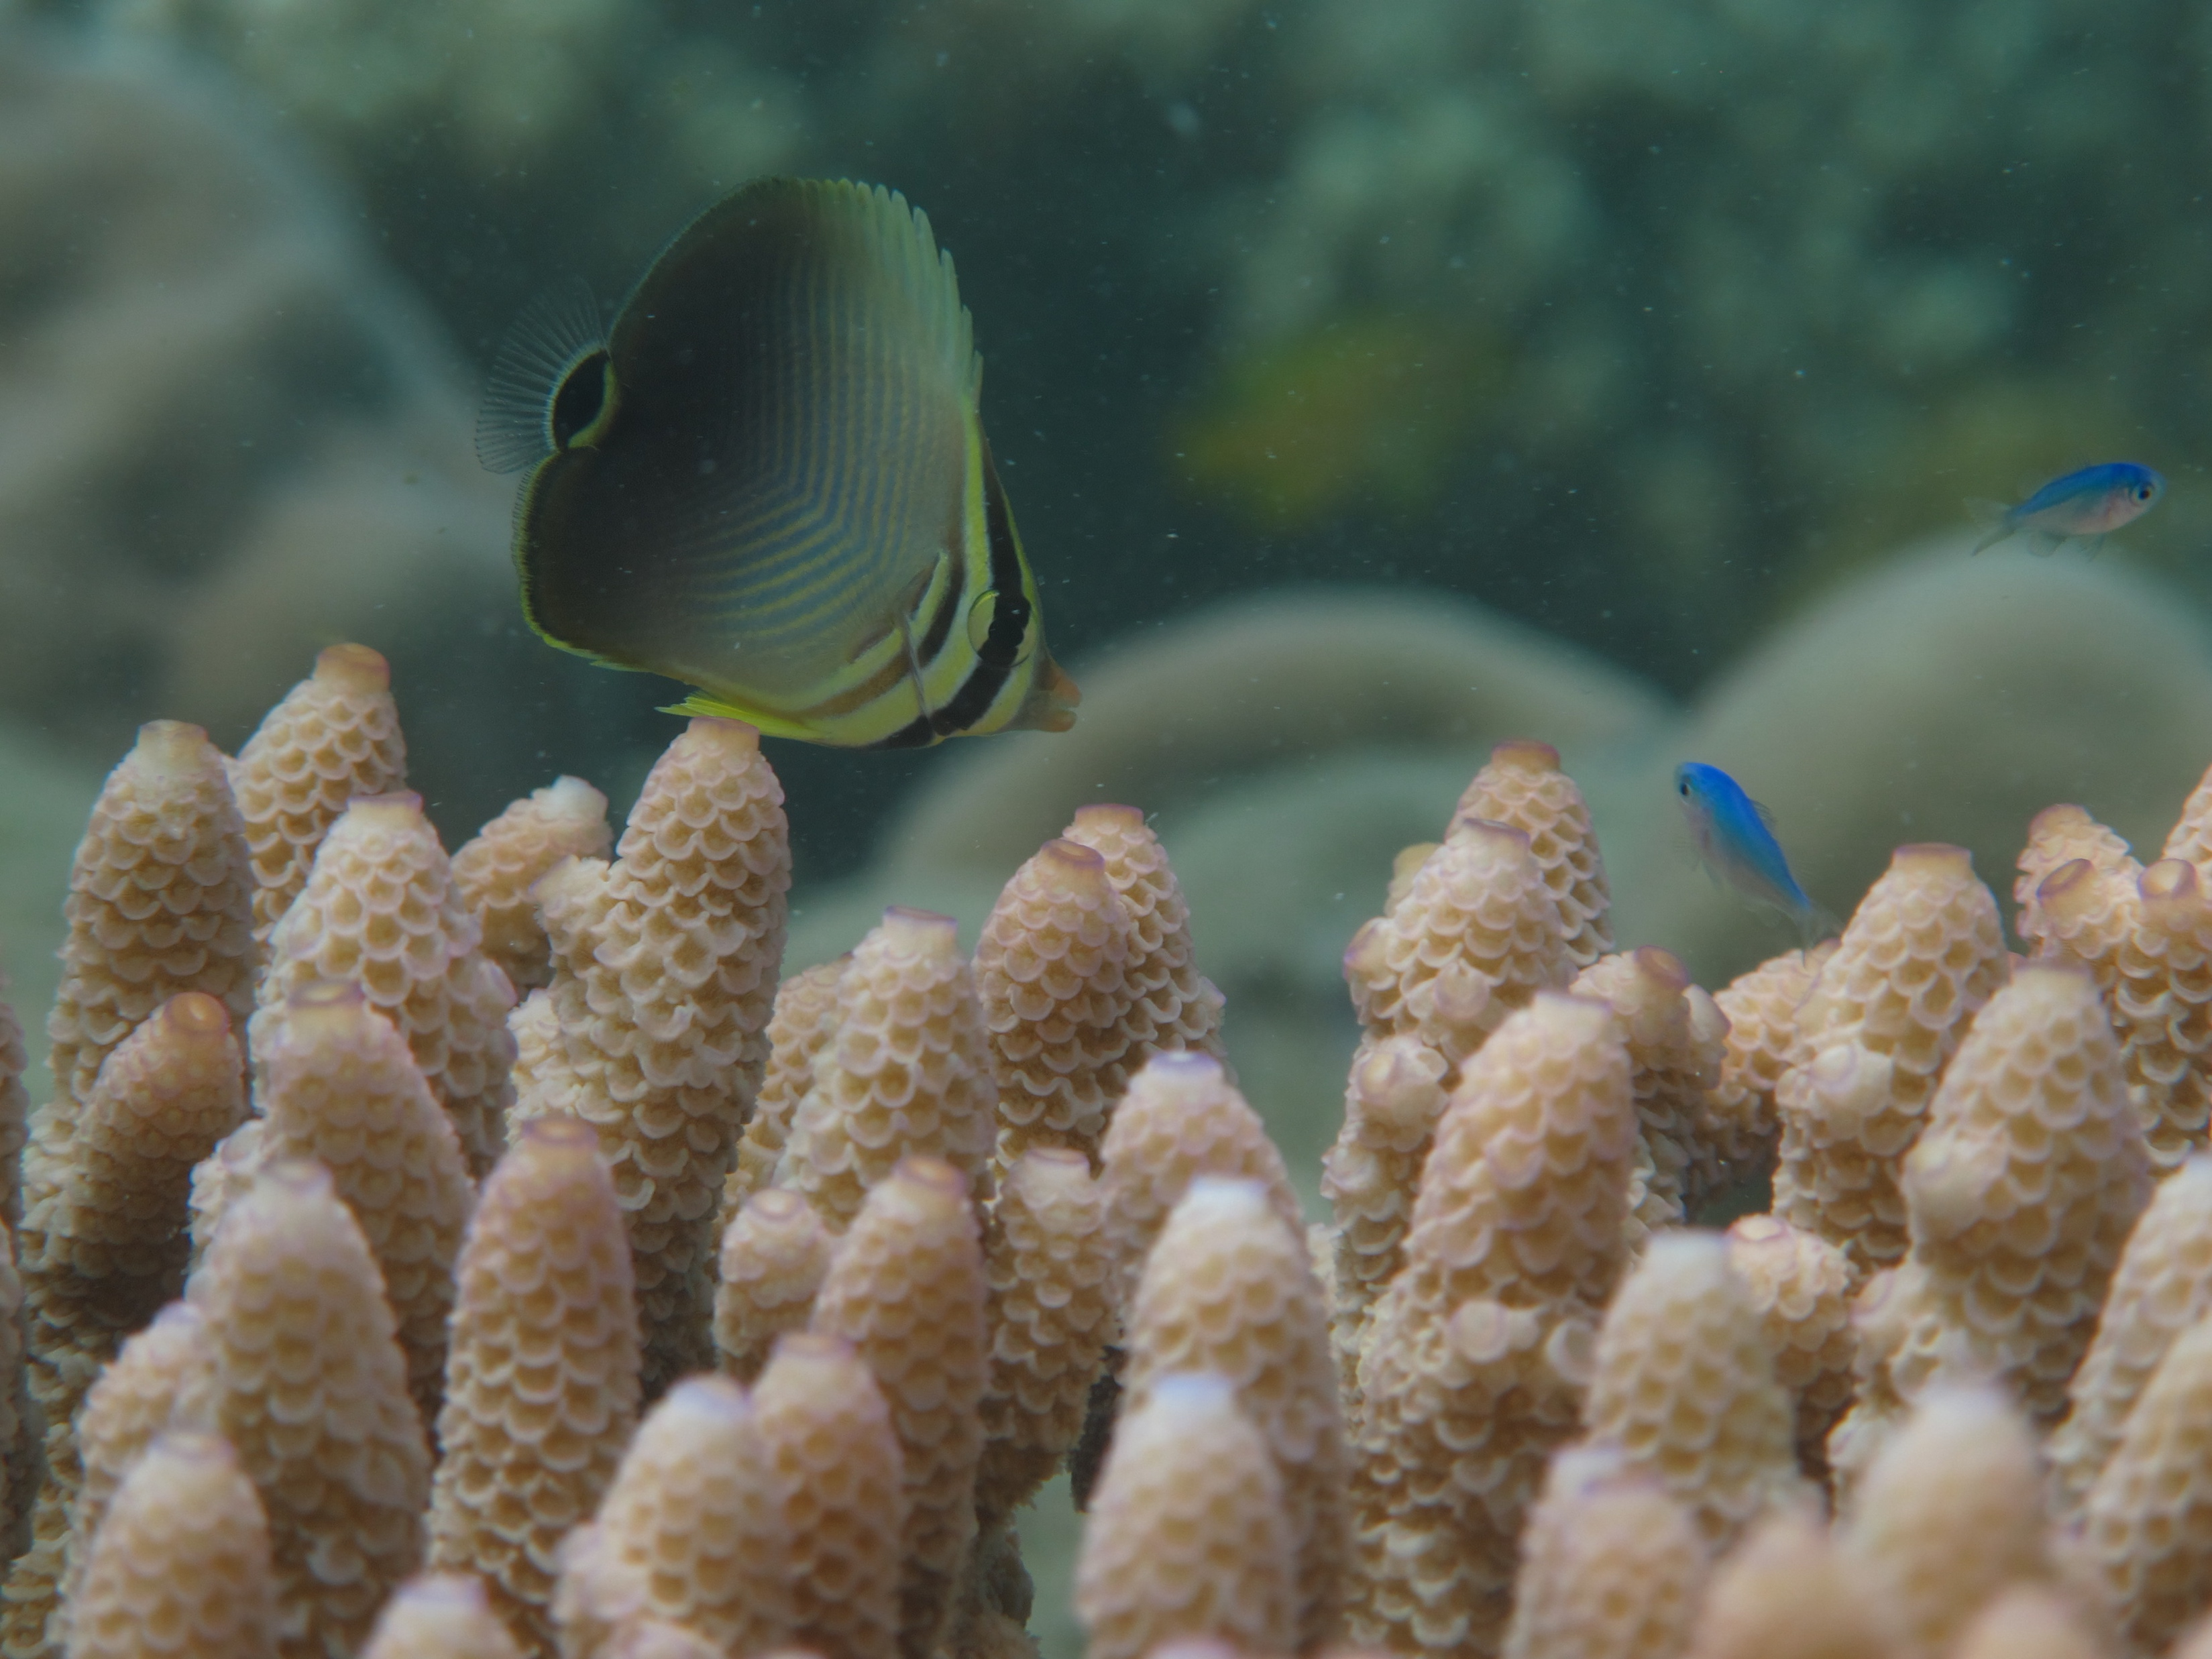
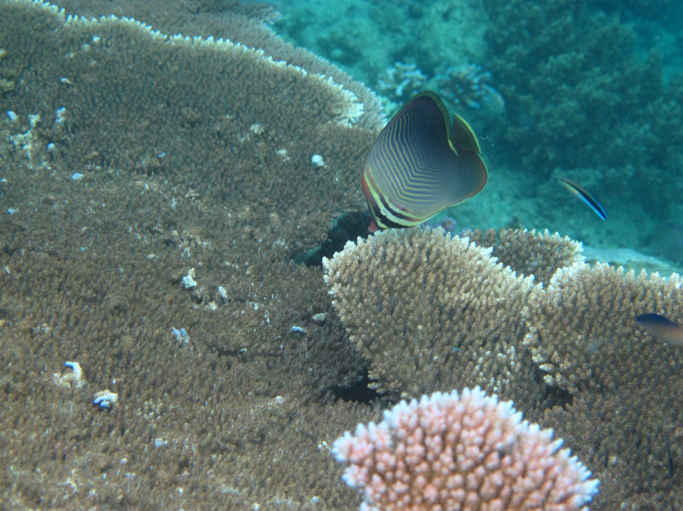
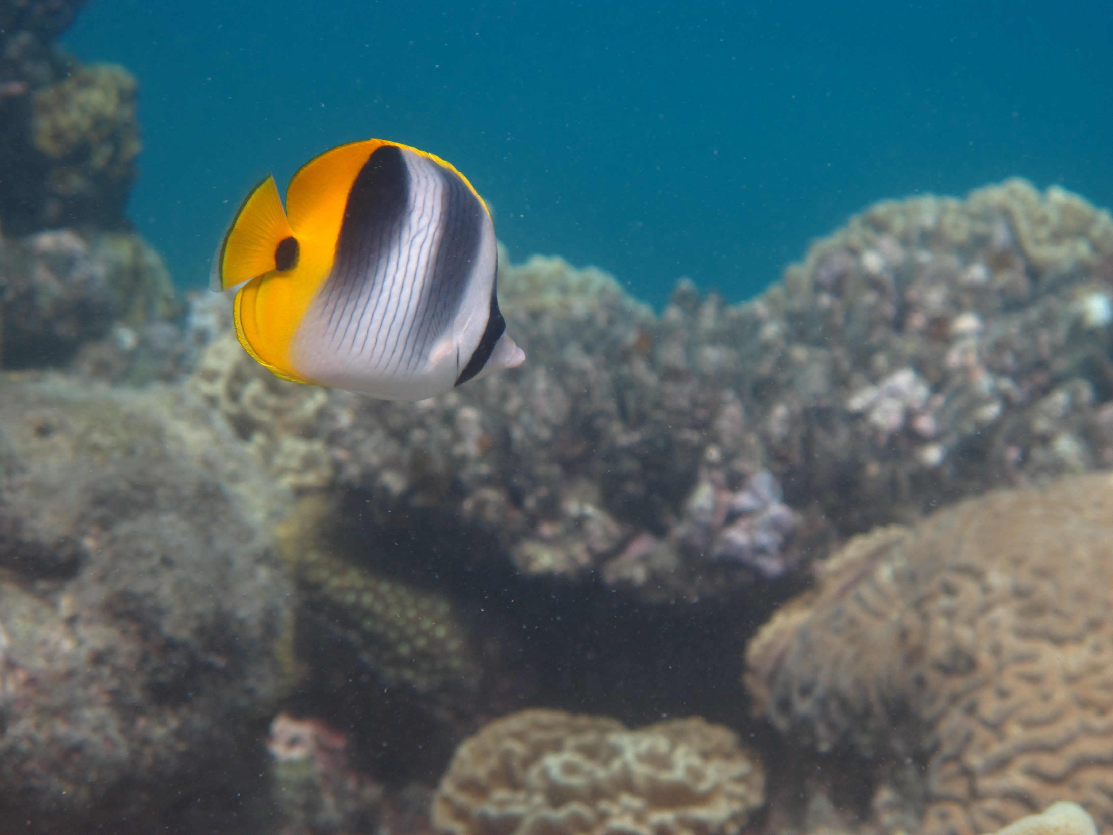
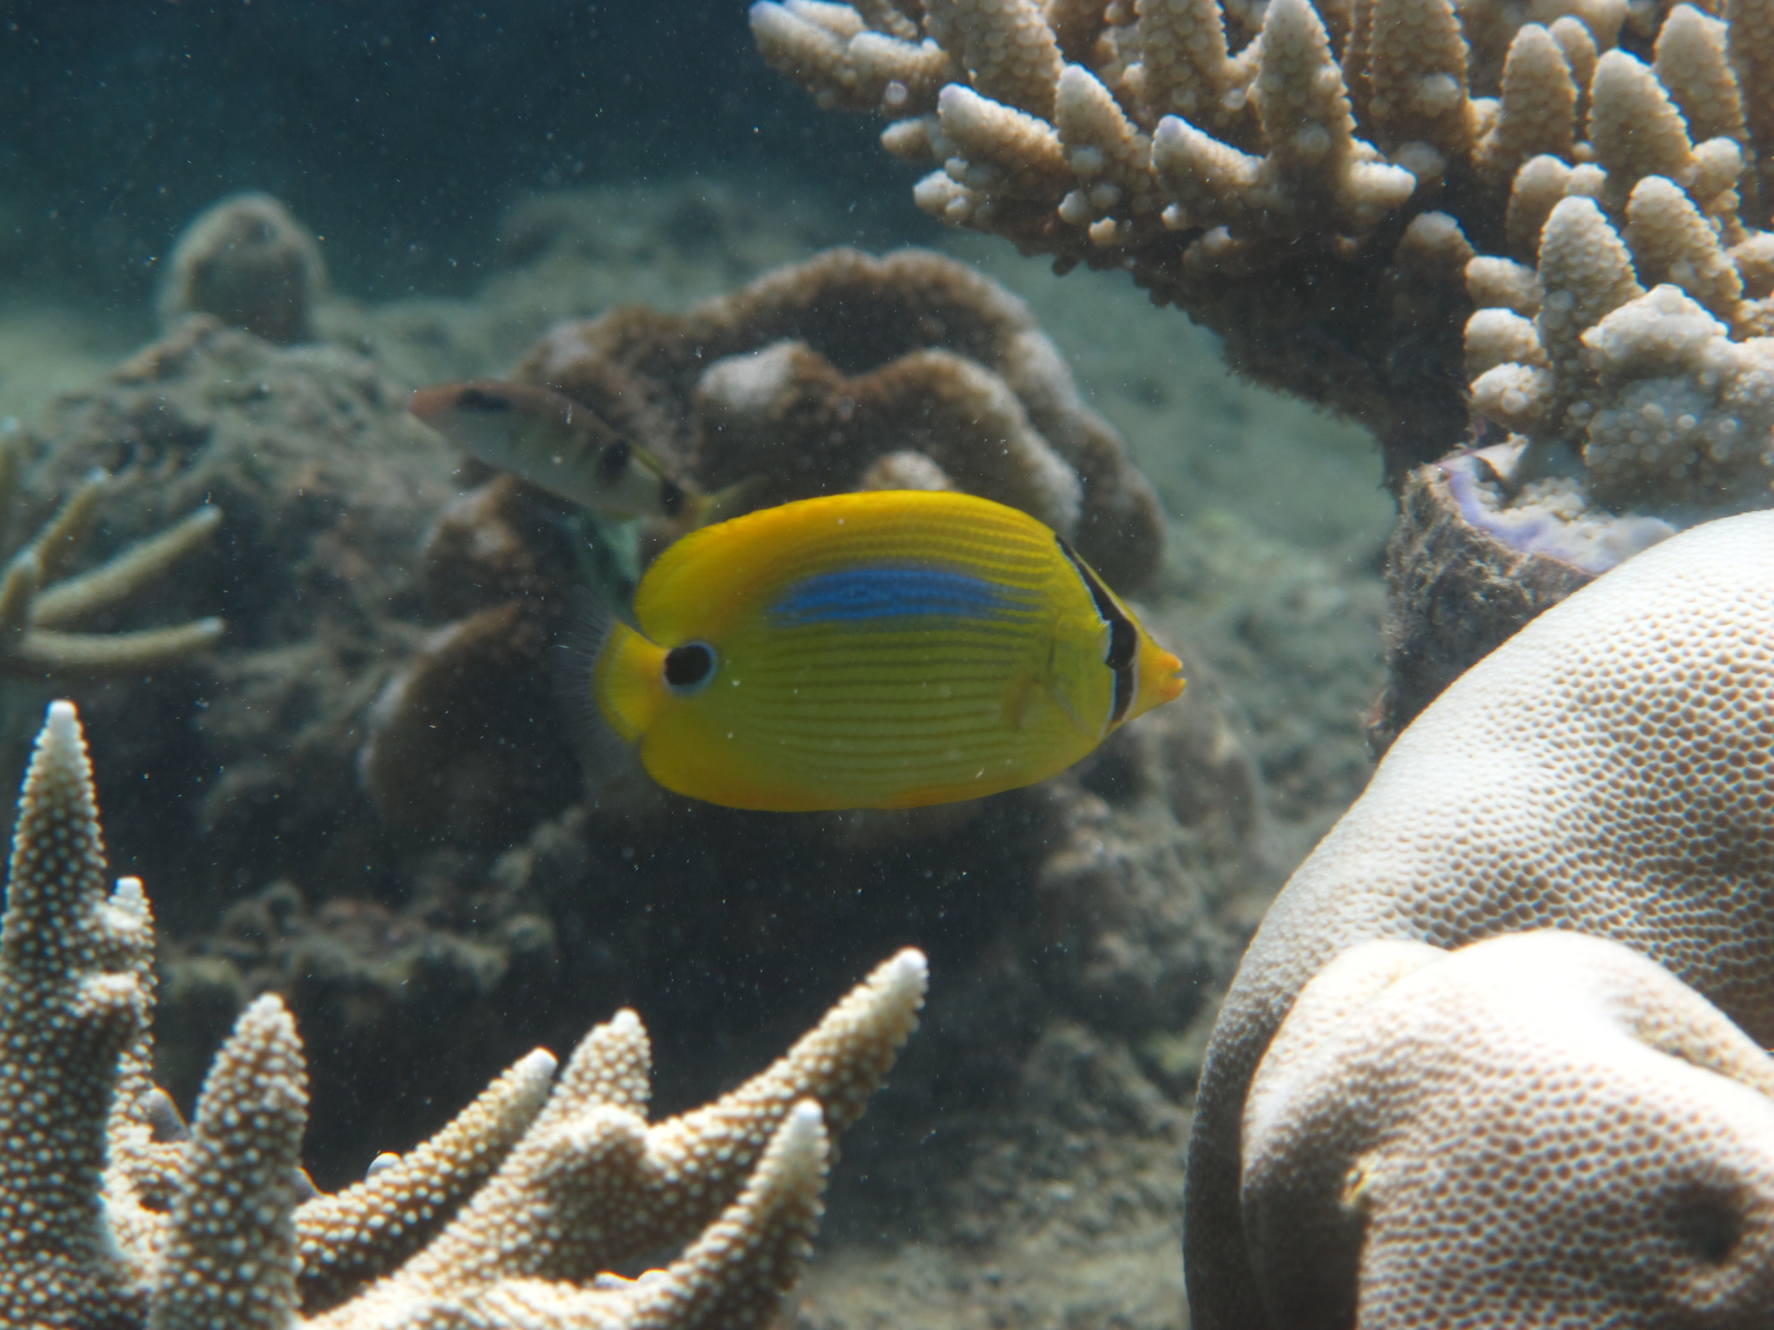
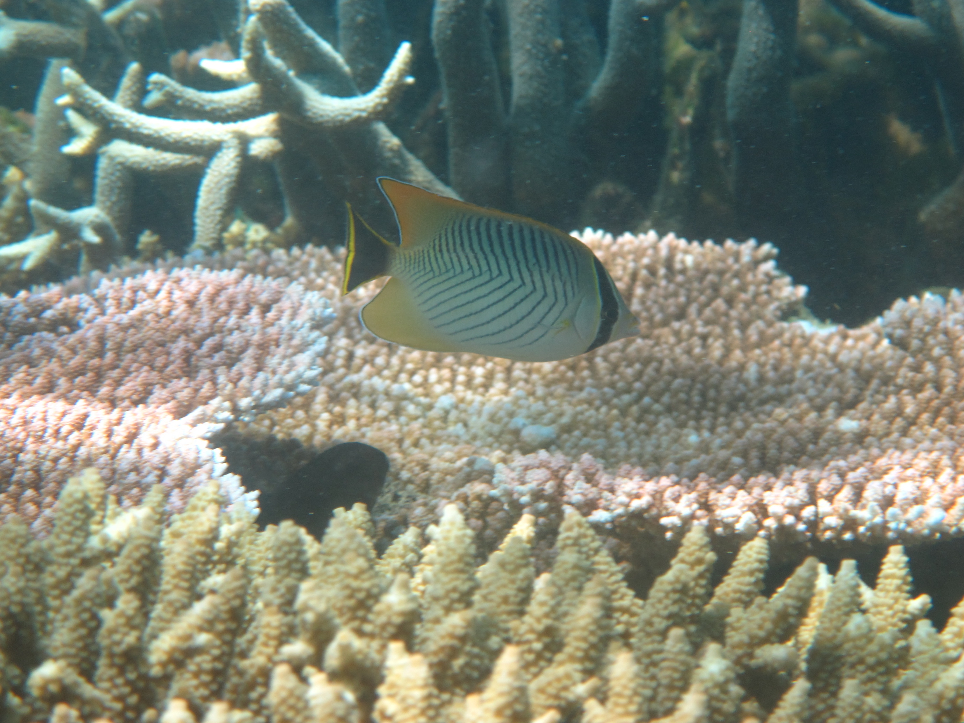
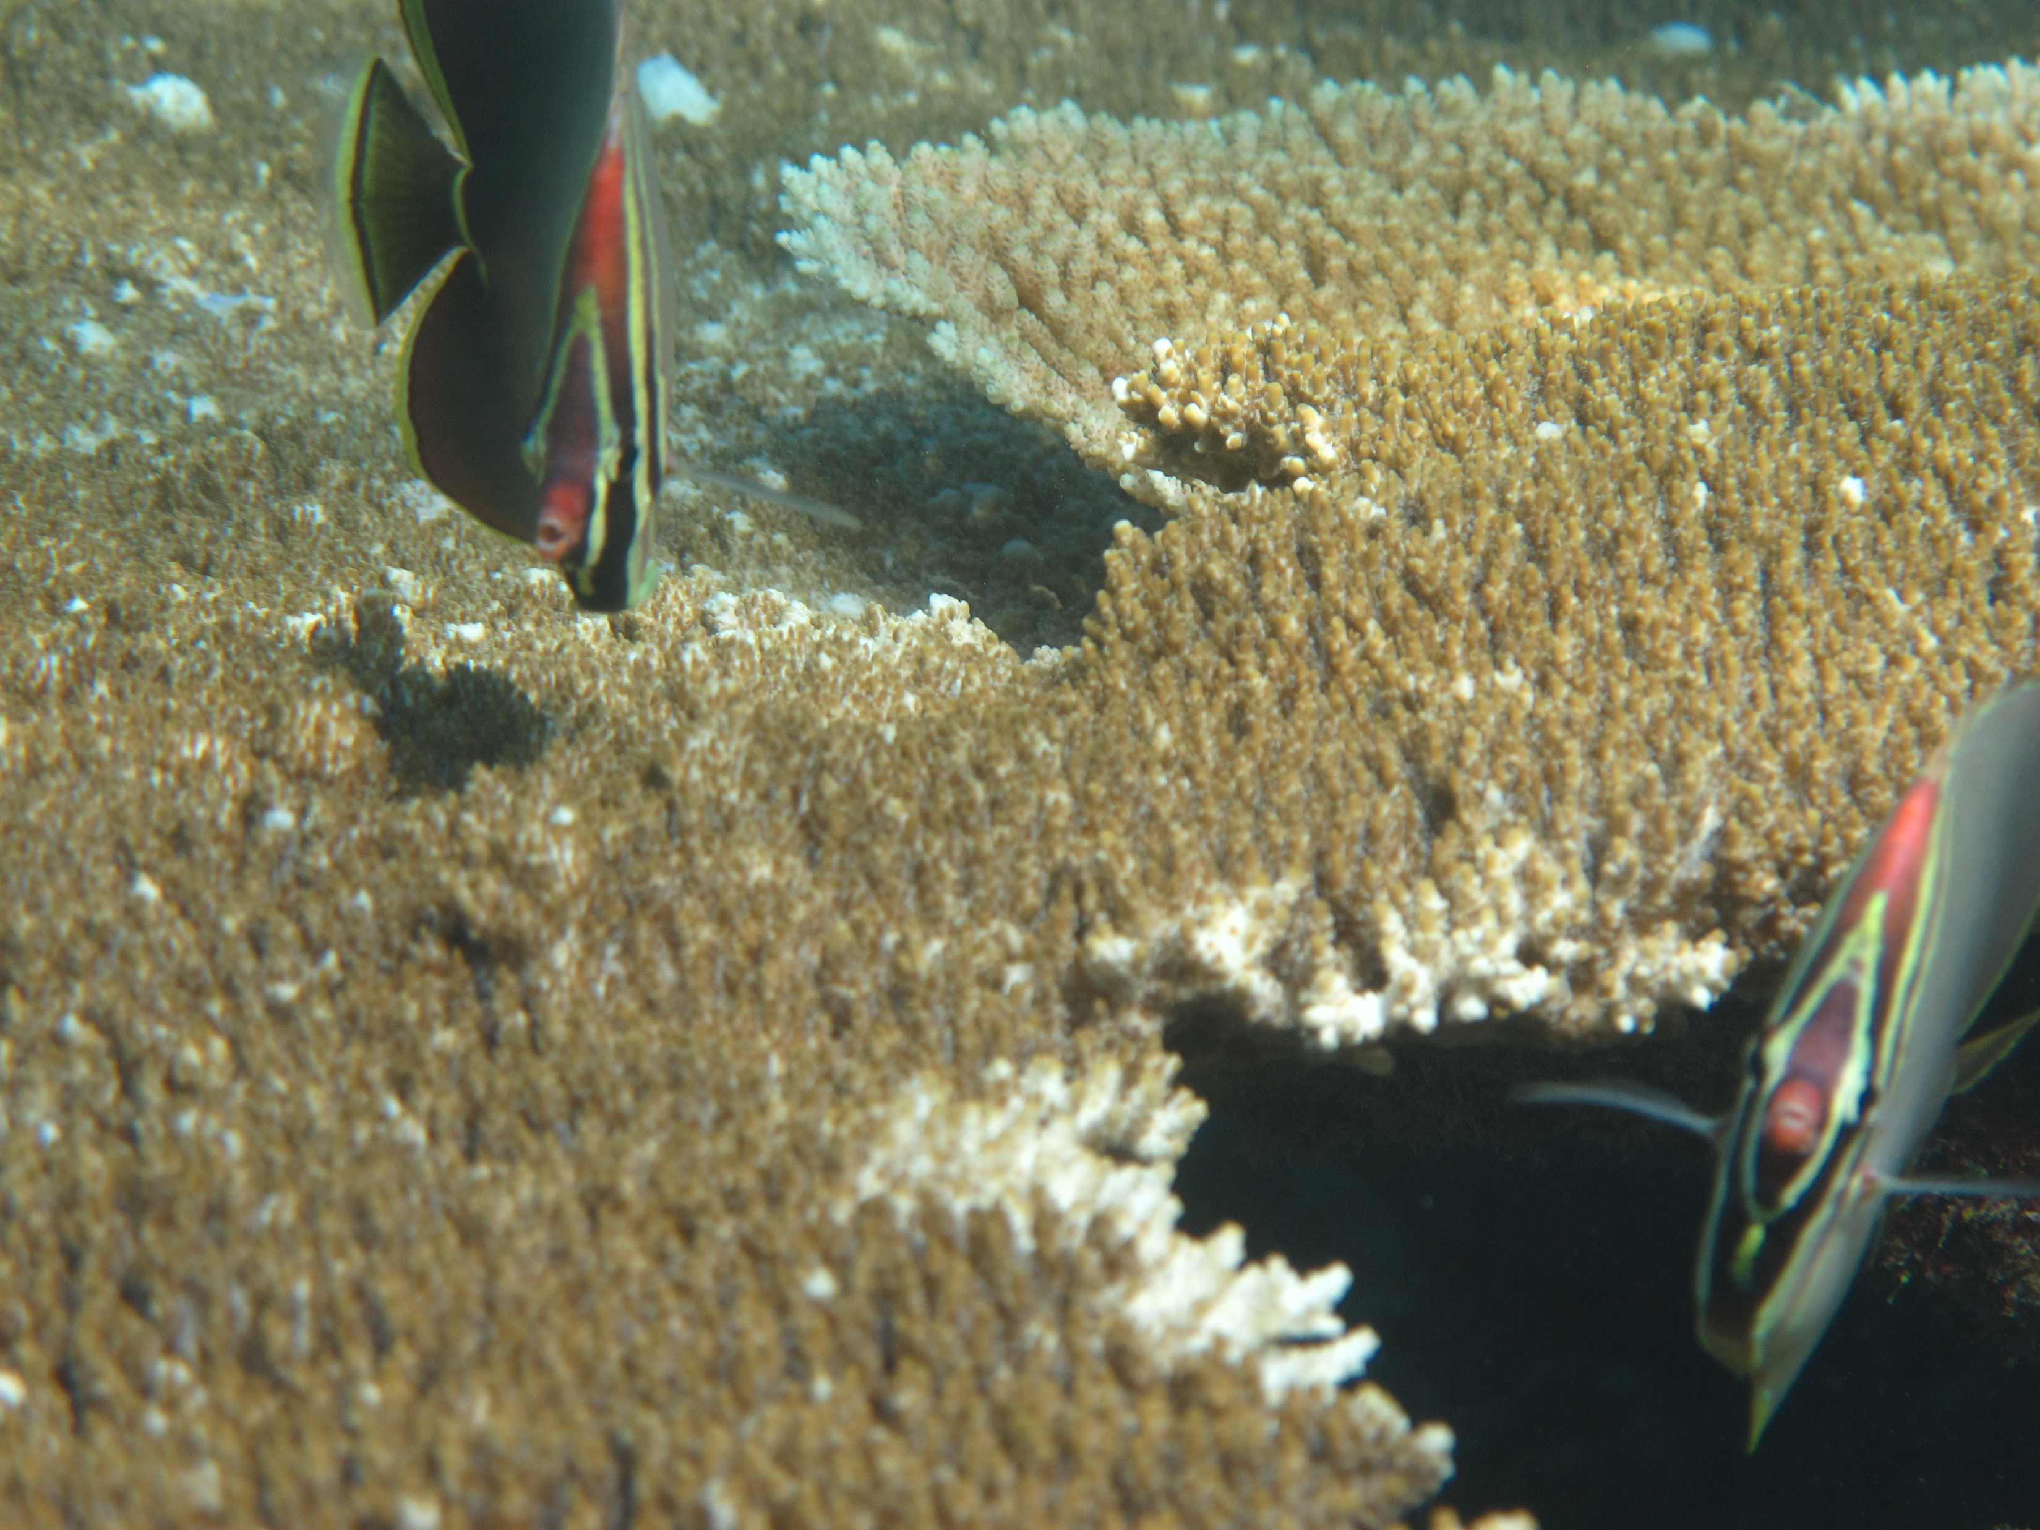
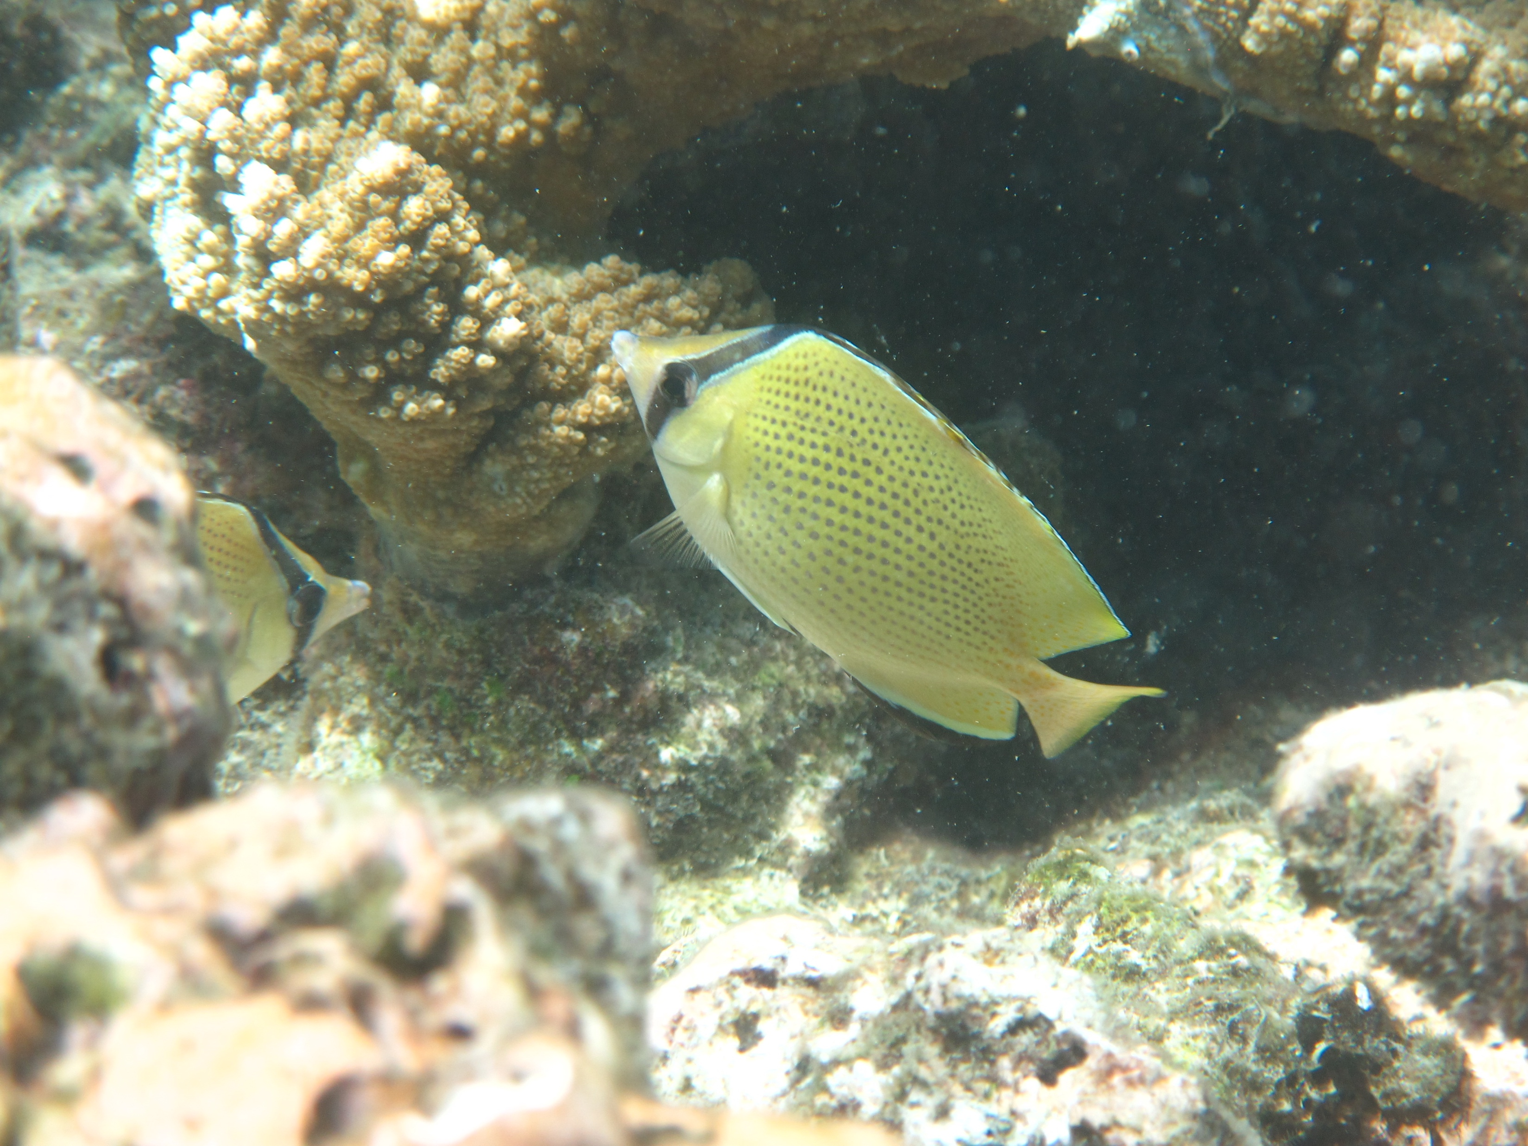
Recap I: what is biodiversity?

Slide 3
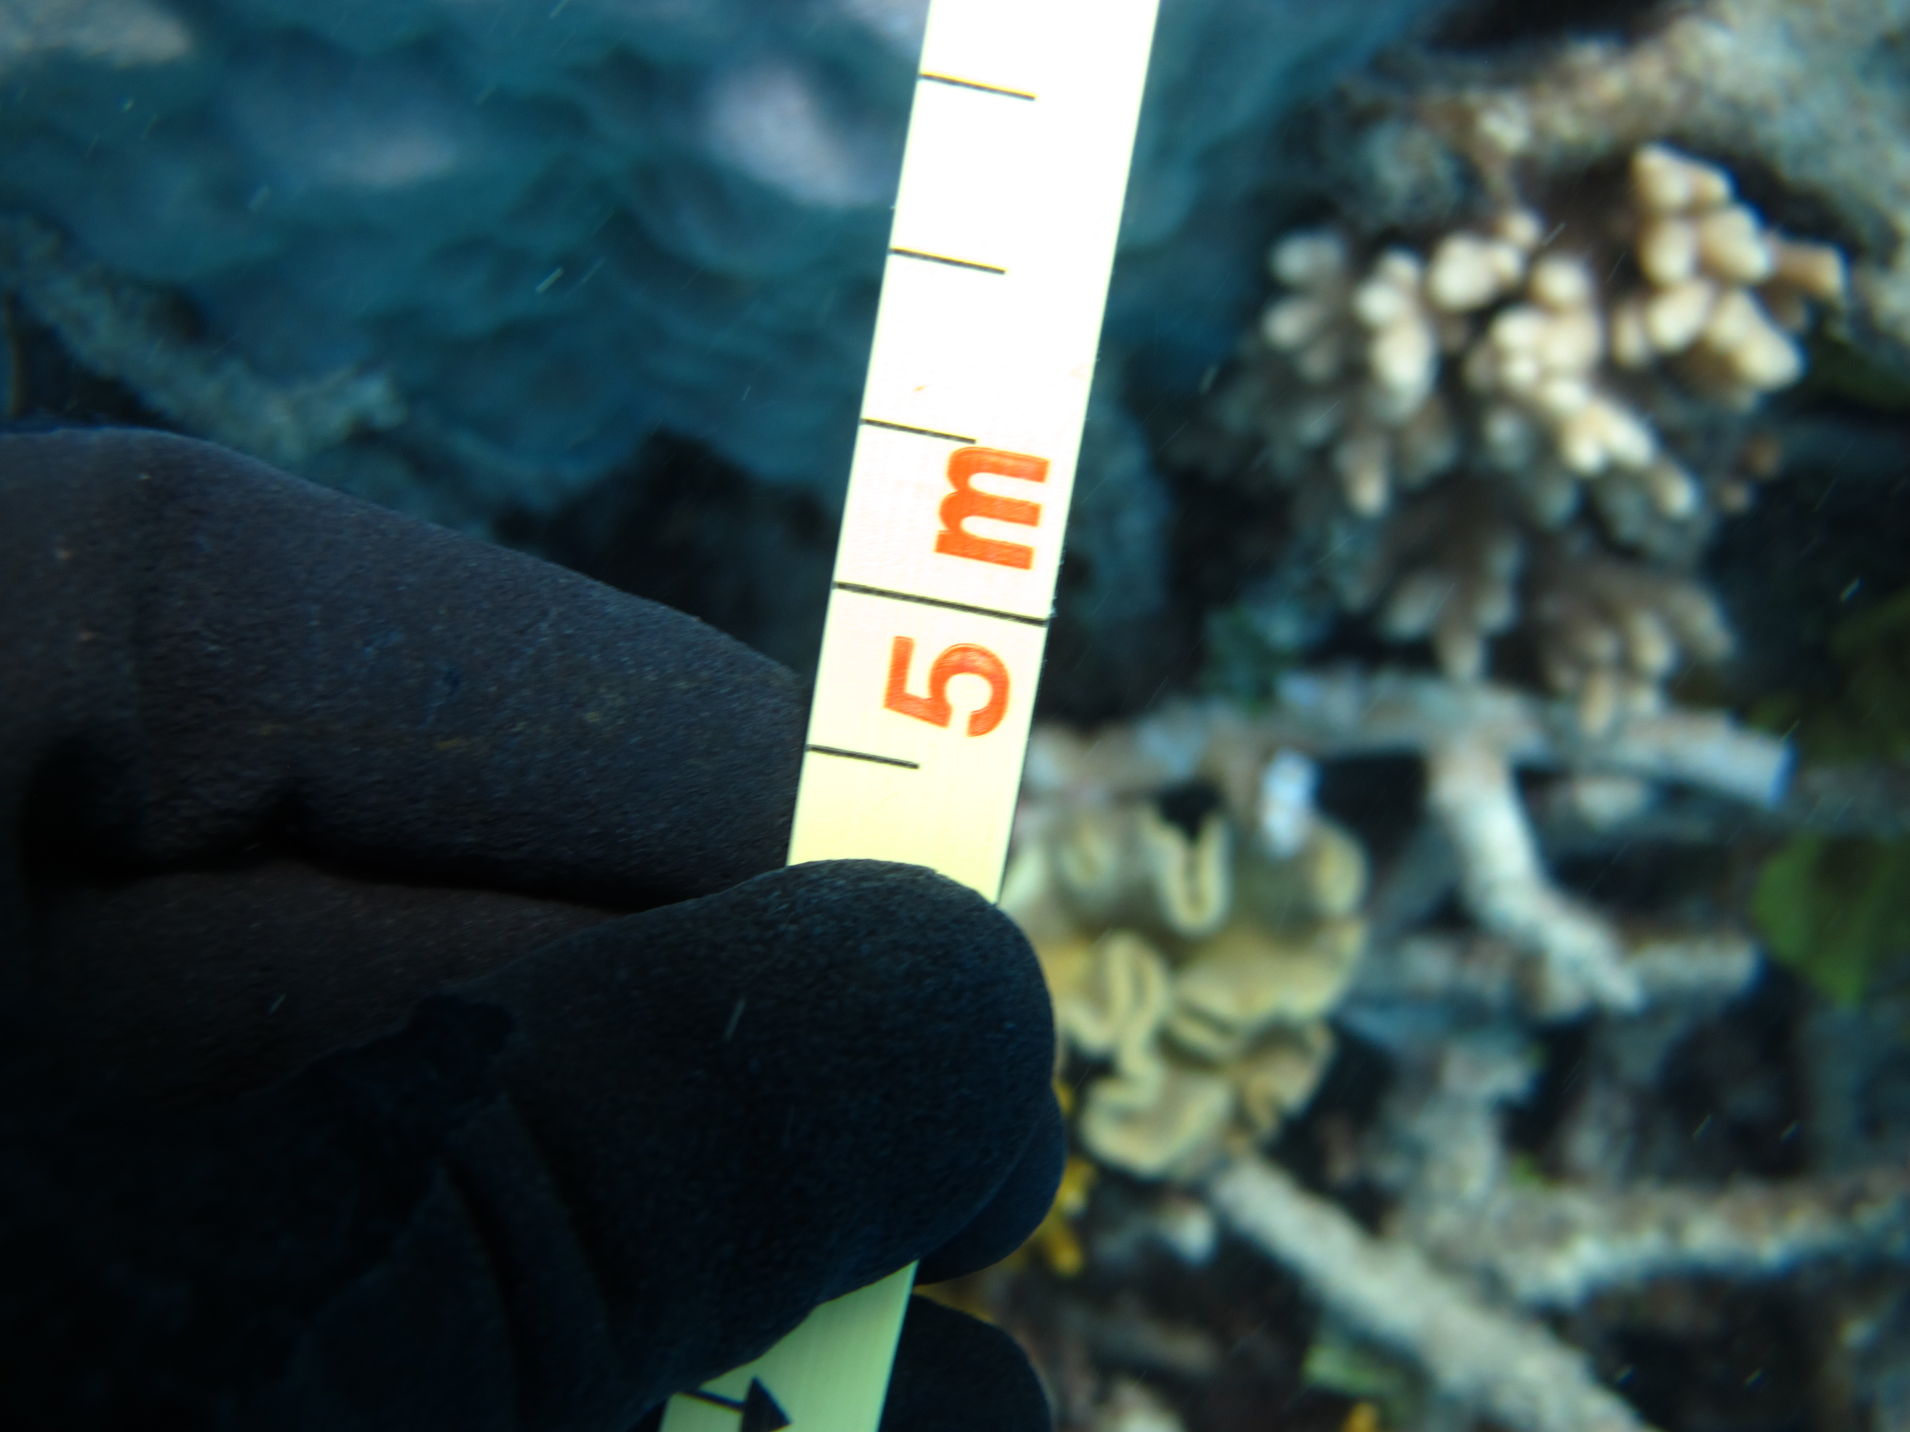
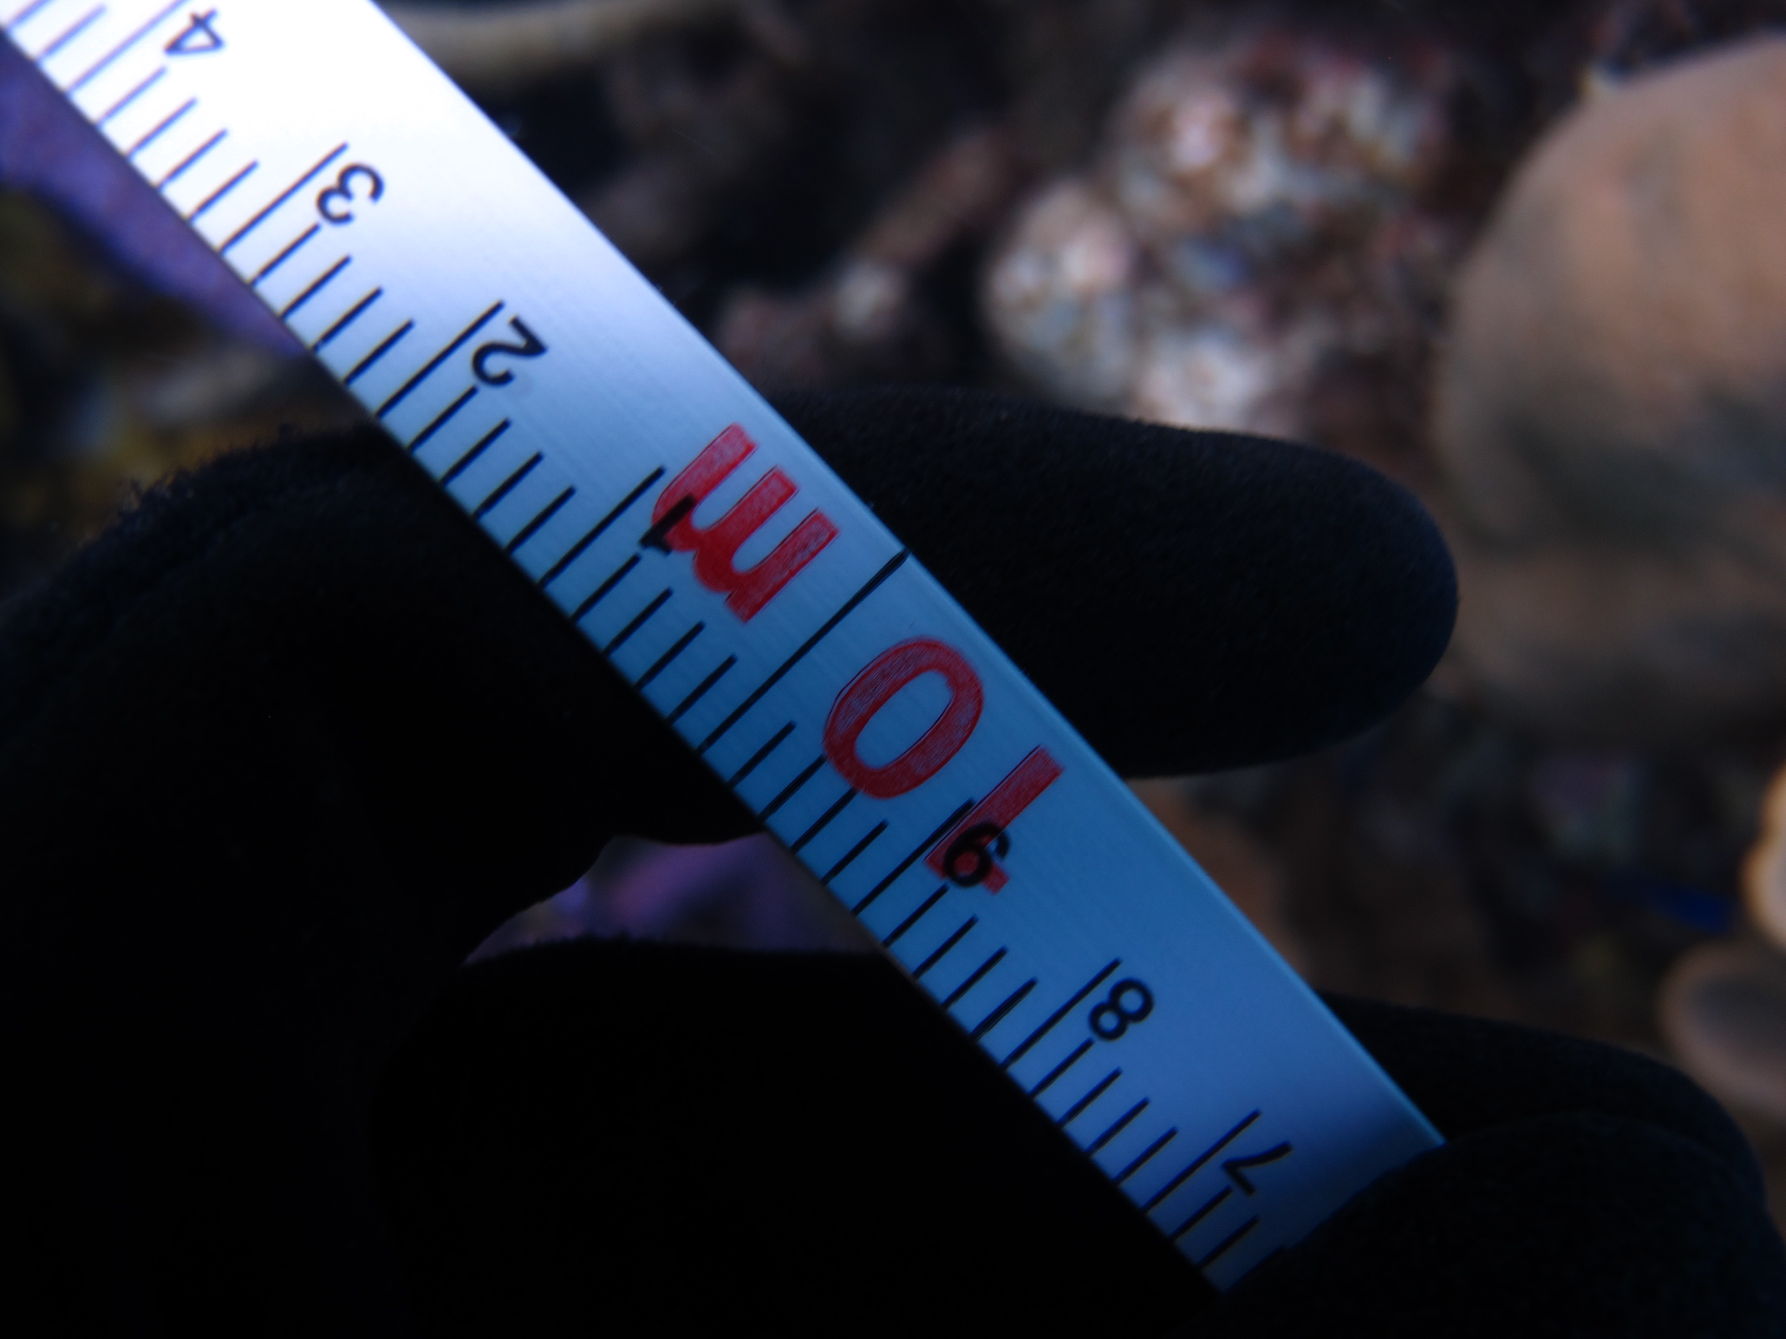
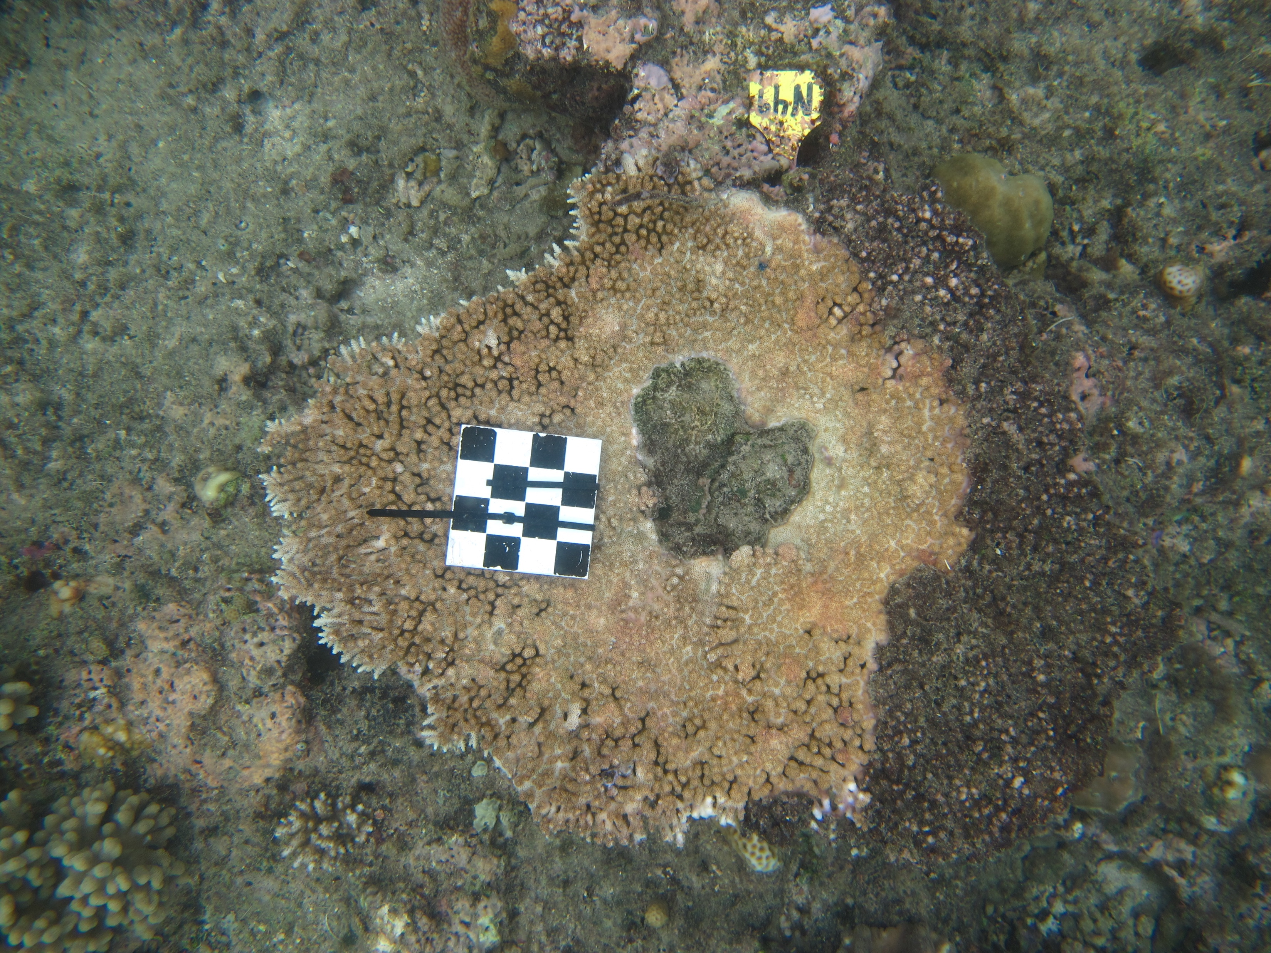
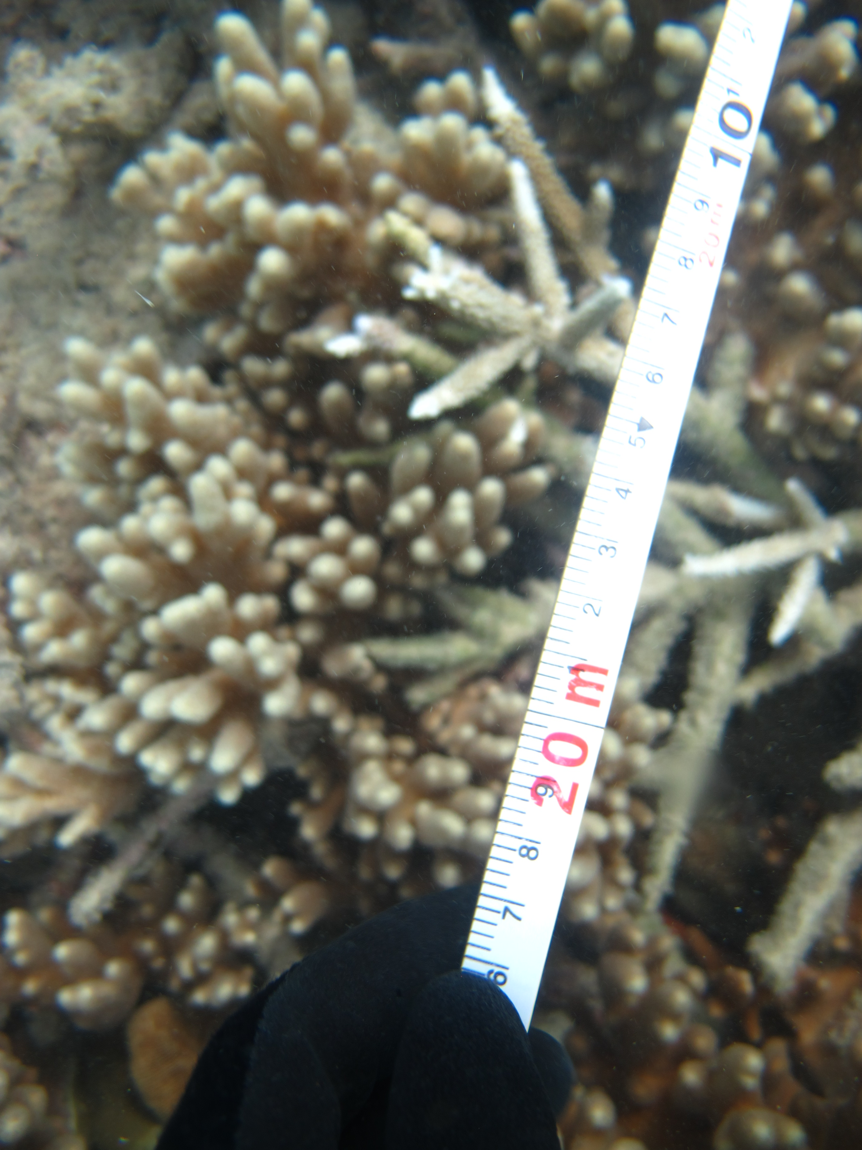
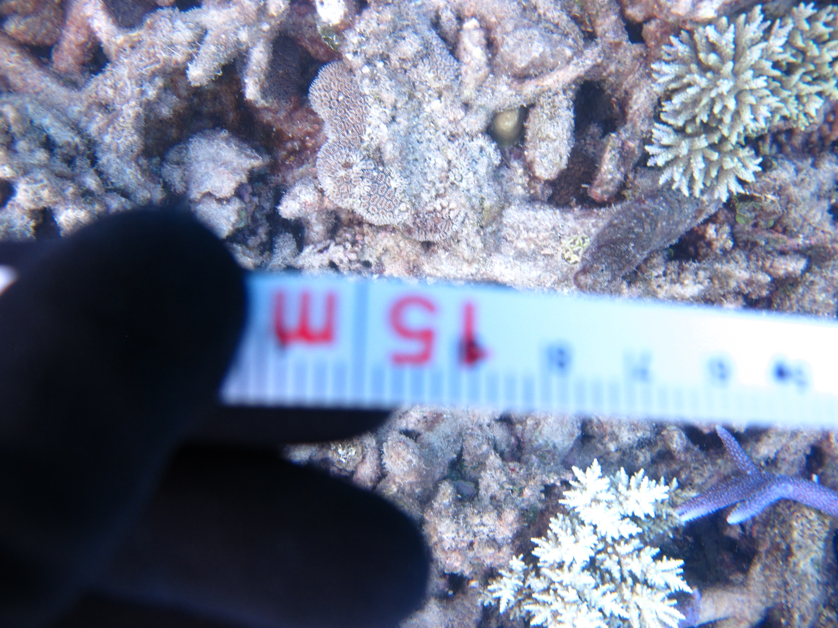
Recap II: Scale
Why? Types?

Slide 4
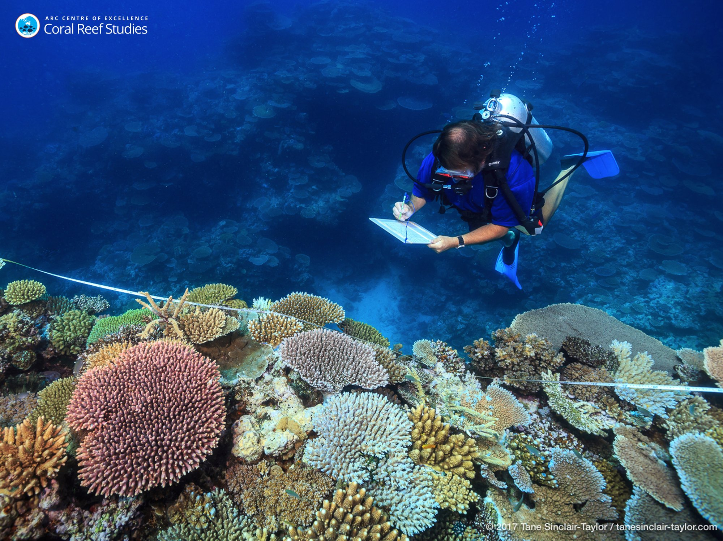
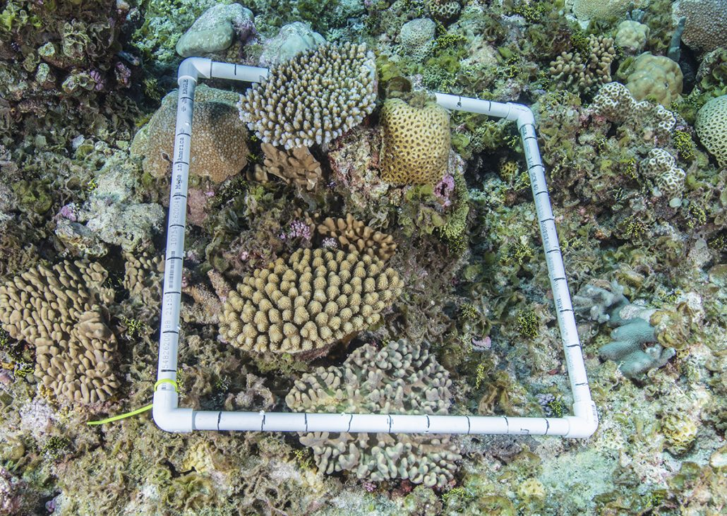
How to measure biodiversity?
Typically starts with a ‘sample’
quadrat
transect

Slide 5

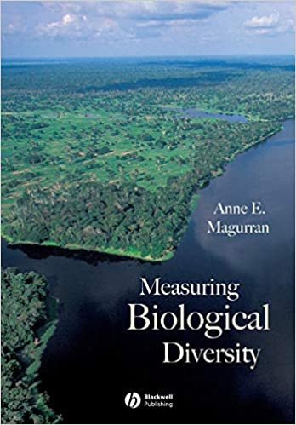
How to measure biodiversity?
Choose a metric…

Slide 6
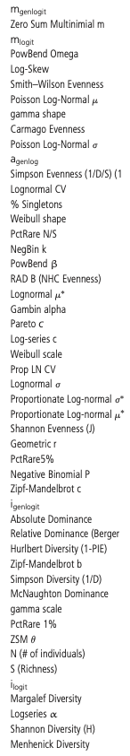
How to measure biodiversity?
Choose a metric…
…but there are a LOT of
metrics to choose from!
McGill 2011

Slide 7
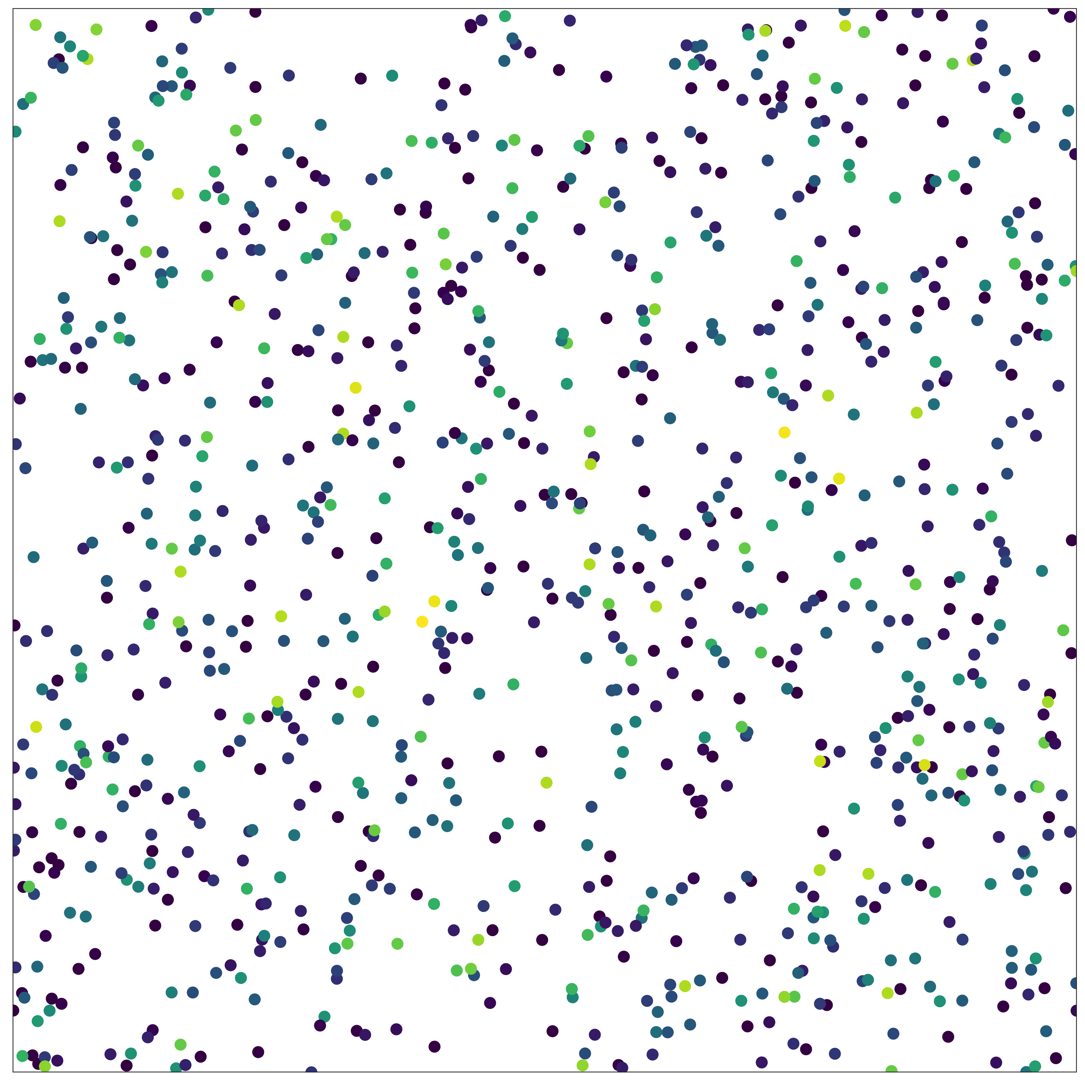
How to measure biodiversity?
Multiple components:
number of individuals (N)
relative abundance of species (evenness)
total number of species (richness)
Different metrics incorporate
these components to varying degrees, but key axes of variation are abundance, evenness and richness (McGill 2011)

Slide 8
How to measure biodiversity?
Multiple components:
number of individuals (N)
relative abundance of species (evenness)
total number of species (richness)
Different metrics incorporate
these components to varying degrees, but key axes of variation are abundance, evenness and richness (McGill 2011)
Want to use rarefaction to examine:
Component (abundance, evenness and richness) changes , and
Scale-dependent changes

Slide 9
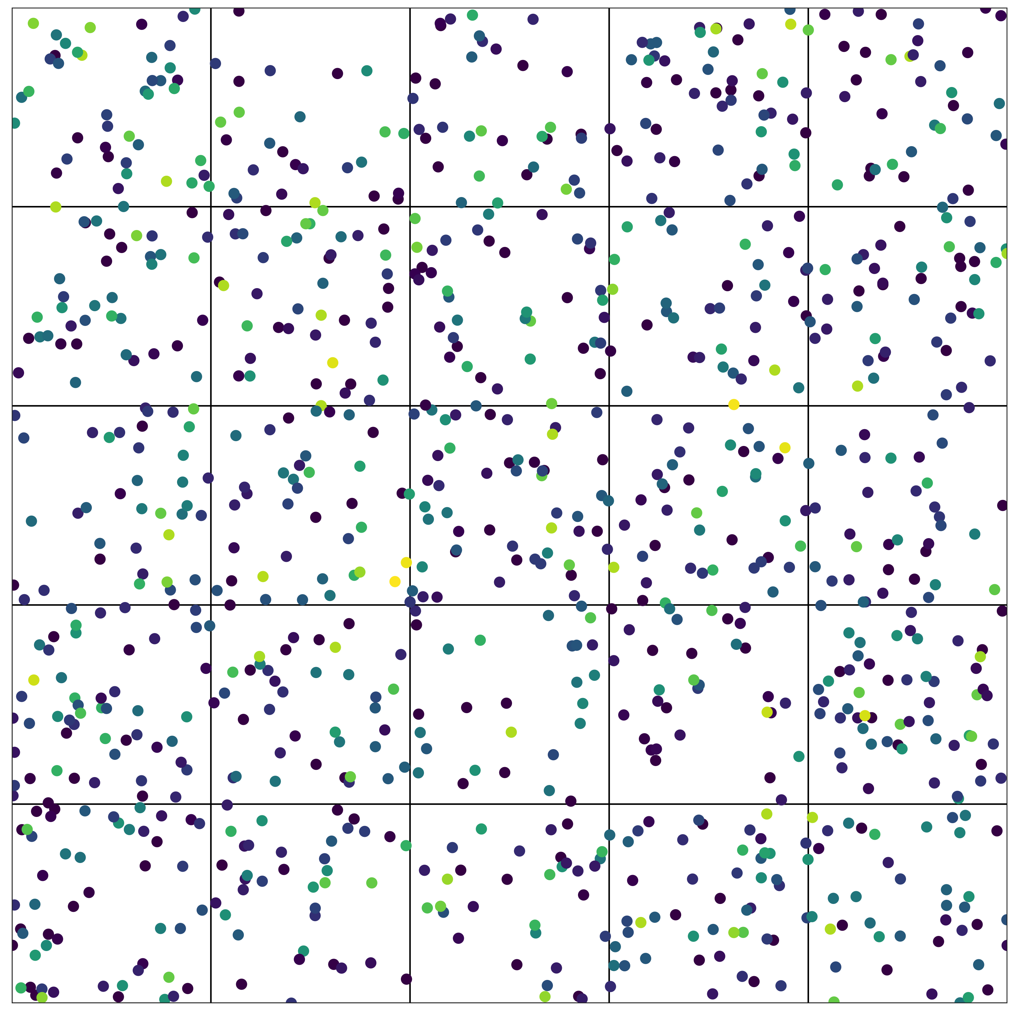
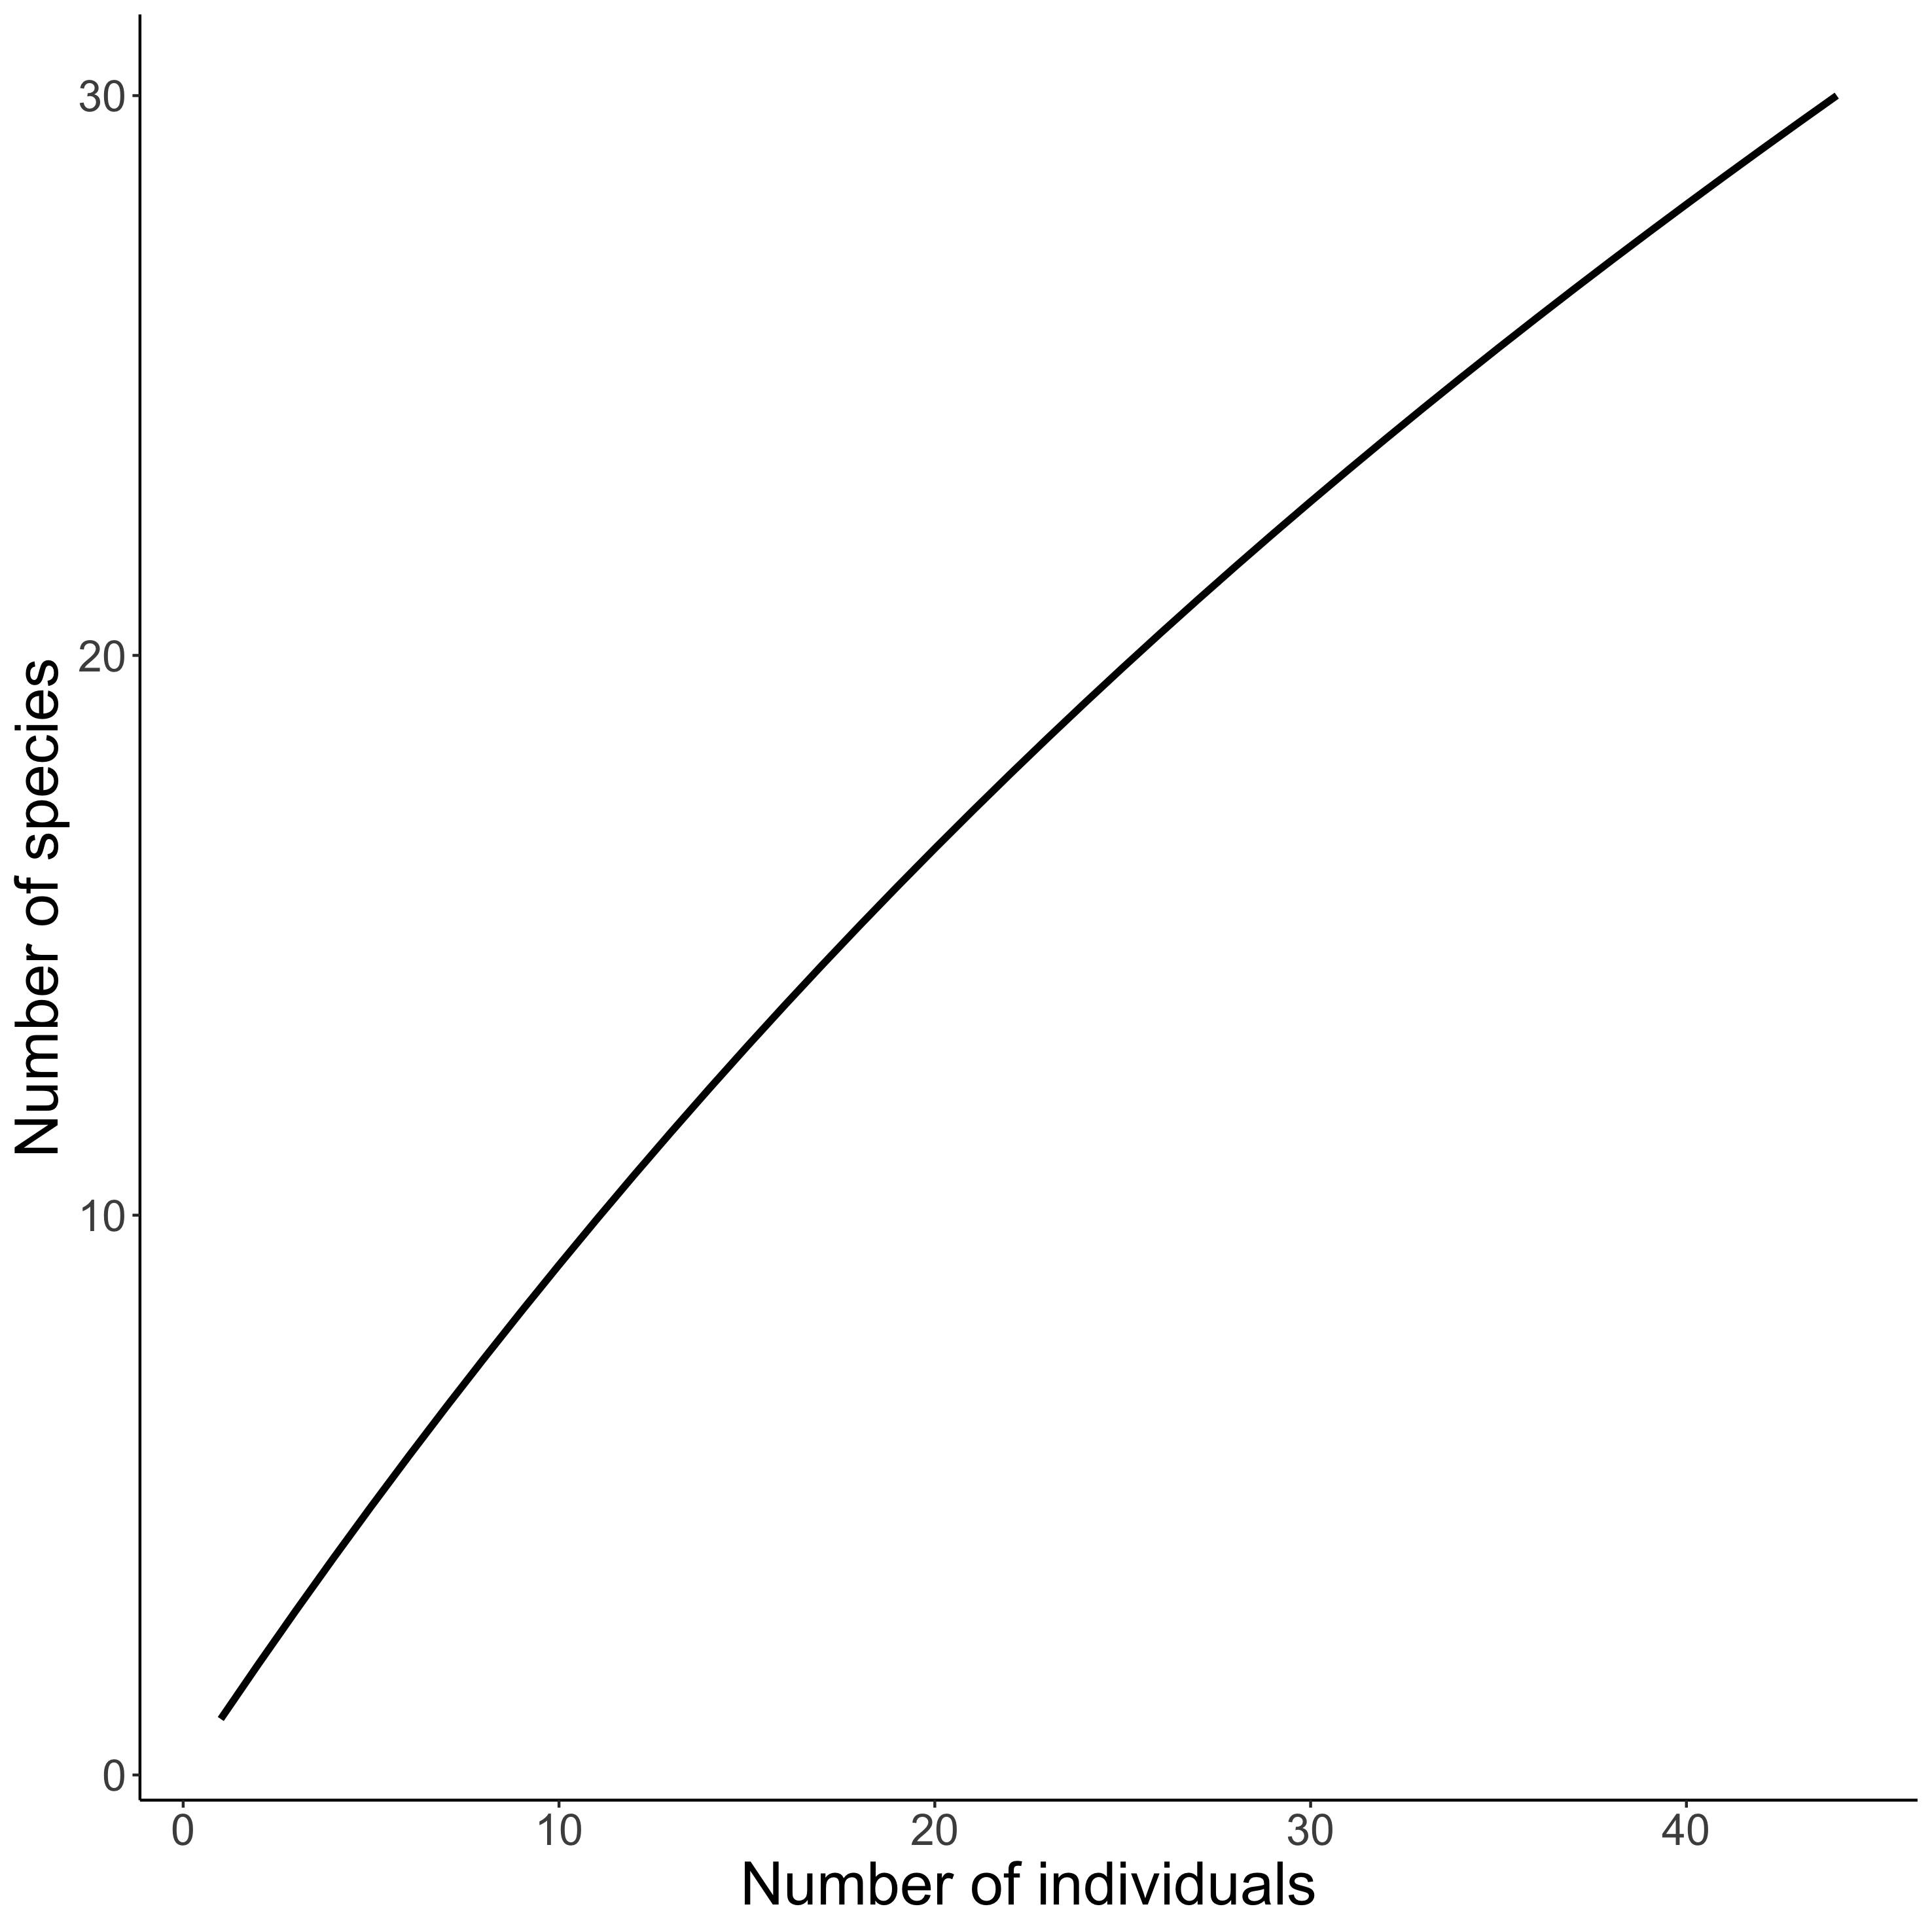
Visualising biodiversity through the lens of Individual Based Rarefaction (IBR)
𝛼-scale
Hurlbert 1971 Ecology, Gotelli & Colwell 2001 Ecol Lett

Slide 10
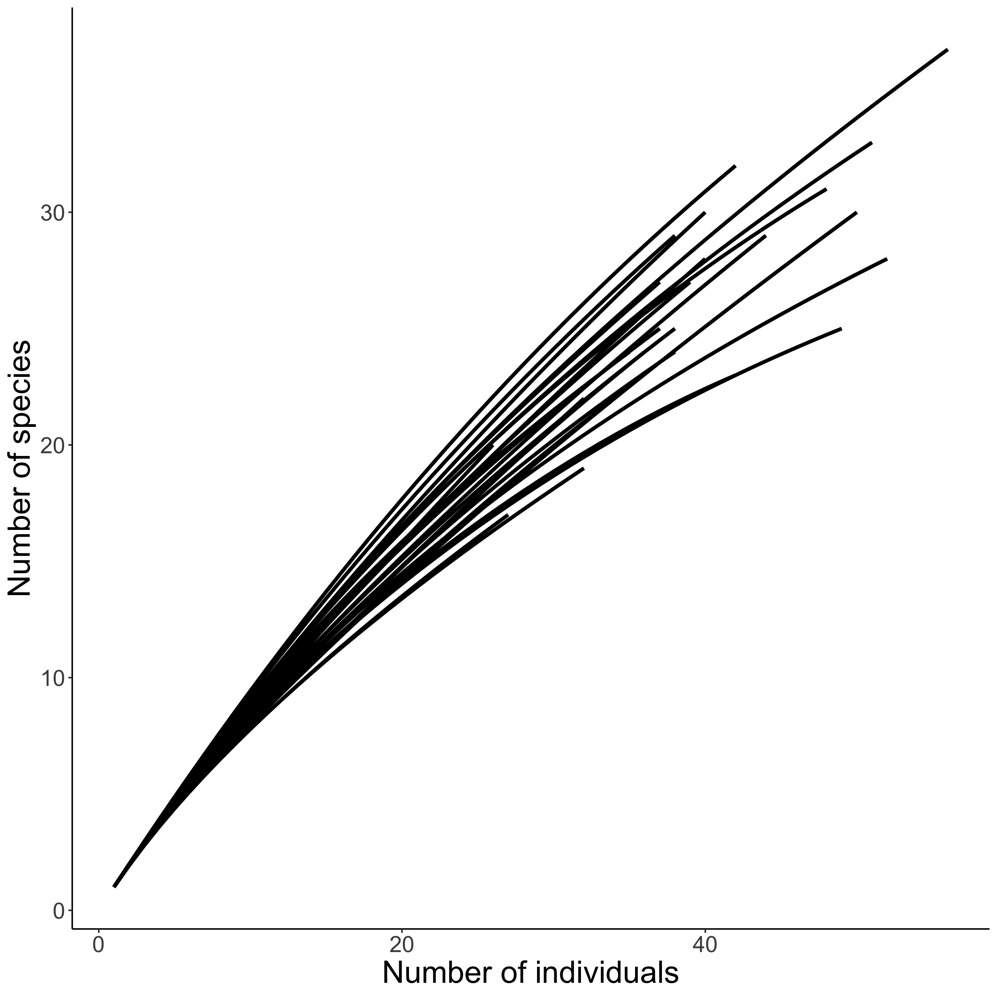
Visualising biodiversity through the lens of Individual Based Rarefaction (IBR)
𝛼-scale : each curve corresponds to one quadrat
Hurlbert 1971 Ecology, Gotelli & Colwell 2001 Ecol Lett

